Slide 1
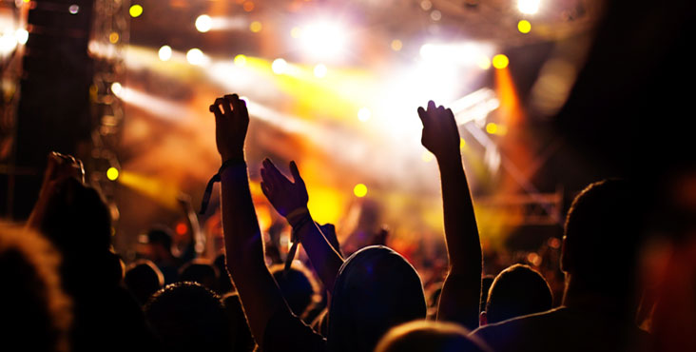

Event Recommender
Dhiviya Dhanasekar | Kushal Palesha |Prathiba Nagarajan

Slide 2
Outline
Why an events recommender?
Implementation
Results

Slide 3

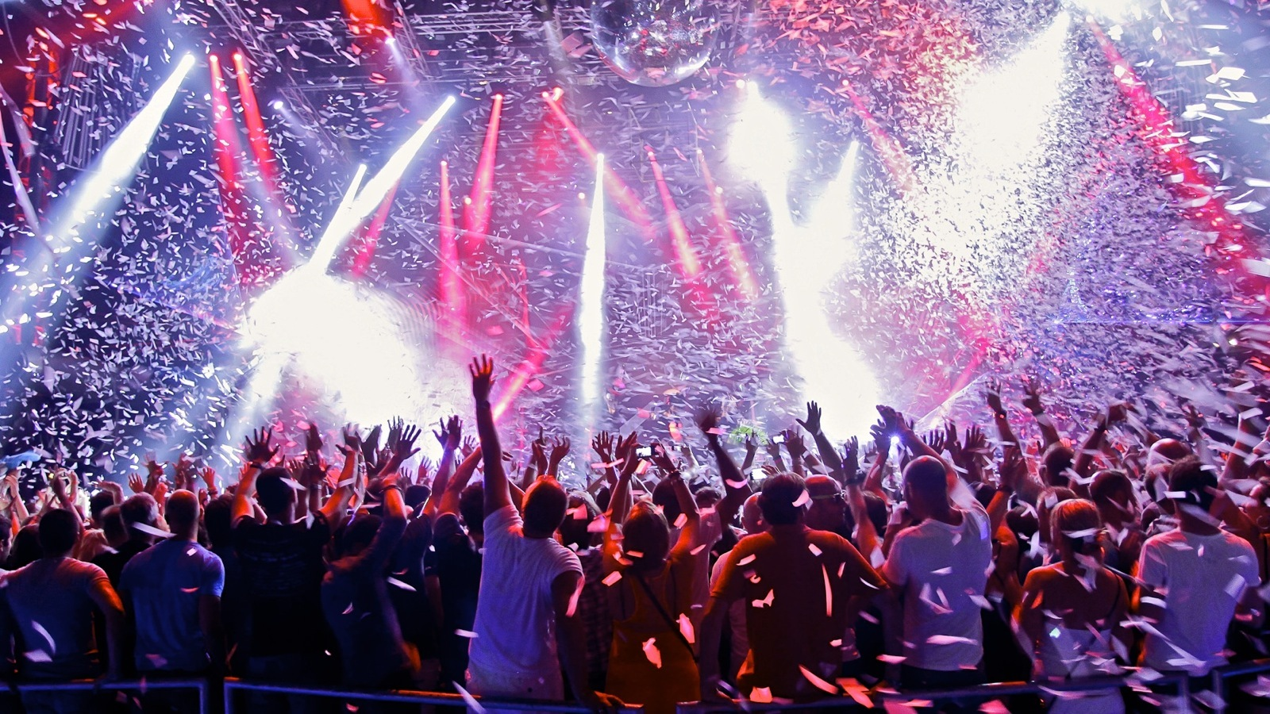

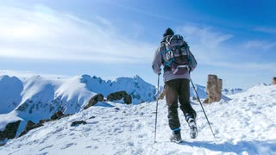

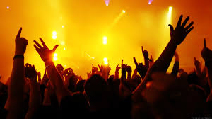
What does Homer like?

Slide 4



How?
Use event descriptions.
Calculate TF-IDF for the 100 most frequently occurring words in the description.
TF – Term Frequency
IDF – Inverse Document Frequency
Use Cosine Similarity to gauge the similarity of the new event to Homer’s likes and dislikes.

Slide 5
Using what?
Events: Interested & Uninterested
HBase
Incoming Event for particular User
User
Data
MapReduce
Cosine Similarity
Events
MapReduce
TF - IDF
MapReduce
Recommendation Result

Slide 6
Challenges
Too many features/attributes
Bulk Loading into Hbase
Out of RAM – GB of data
Excessive Logging

Slide 7
Demo & Results

Slide 8
Summary

Slide 9
Appendix
Github URL: https://github.com/dhiviyadhanasekar/Events_Recommender
Dataset: https://www.kaggle.com/c/event-recommendation-engine-challenge/data

